Slide 1
College Letters of Recommendation
College Prep
Mr. Gordon
jgordon@bisdtx.org

Slide 2
Upcoming Events
hi

Slide 3
What are Letters of Recommendation
A letter recommending a person for a college, describing their qualifications and skills.
Most universities do not require letters of recommendation, but it can make you a stronger candidate for acceptance.
hi

Slide 4
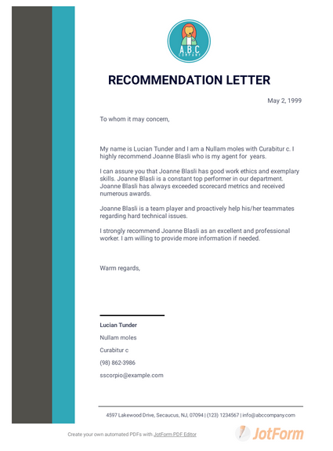
How many do I need?
I recommend three letters total.
Two letters from an educational setting ie. teachers, professors, and school counselors.
One from a community member ie. pastor, non-profit supervisor, employer.
.
hi

Slide 5
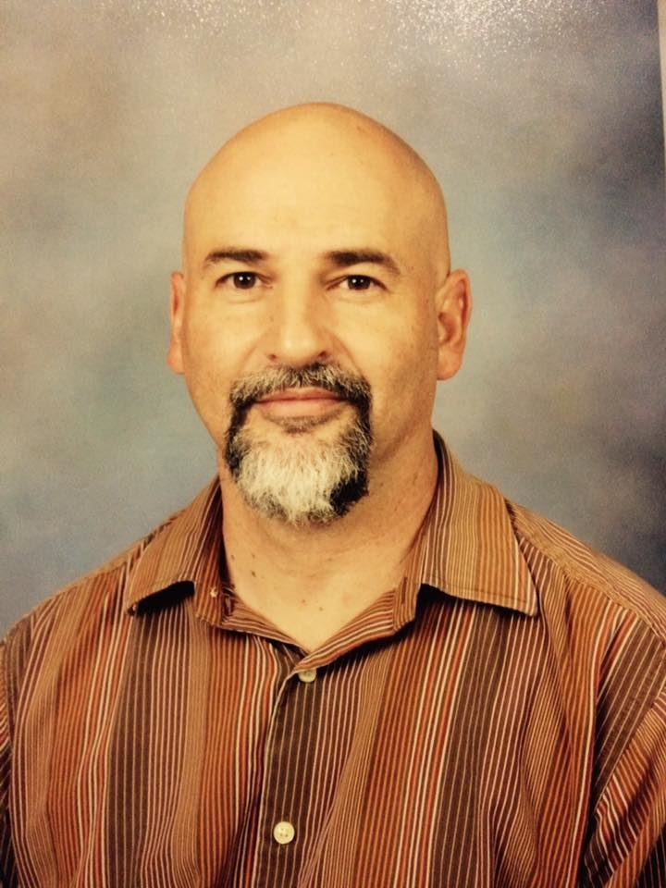
Who should I ask?
Has known you for a year or more
May teach a subject in your future major or career
May be someone who graduated from your
prospective university
Can write a quality letter
This guy
.
hi

Slide 6
When do I need it?
You should ask your prospective letter writers at the beginning of your senior year.
It can take them a few weeks to write it.
Send out a reminder email a few weeks after asking.
You will include the letter of recommendation with your college application.
.
hi

Slide 7
What information should I give my letter writer?
CRCA and ACC GPA
Colleges you are applying to
Your major and potential career path
School Clubs and Organizations ex. StuCo, NHS, or Spanish. (Don’t just say the club, but if you held an officer position and responsibilities.)
Community activities, such as volunteering or jobs
.
hi

Slide 8
Today’s College Prep Assignment
Think of a few people you might ask for a letter of recommendation.
In the comments section of today’s College Prep,
name one thing you would tell your prospective writer.
hi

